Slide 1

Celebrating Christian Helplines
CRE Sandown 2014
Notes:
When Alexander Graham Bell and his assistant Thomas Watson demonstrated their new invention, the telephone, to Western Union in 1876, the company’s executives wrote back “Mr Bell, after careful consideration of your invention, while it is a very interesting novelty, we have come to the conclusion that it has no commercial possibilities”. They added that they saw no future for what was, in effect, no more than “an electrical toy”.
By Jan 1878 public telephones were installed for those who could afford them in this country.

Slide 2
History of Christian Helplines
Notes:
The first use of a telephone for help in a crisis was perhaps in 1878 when Isaac Smith phoned 21 doctors so that they could attend a railroad disaster in Tariffville , USA.
In Britain the first 999 call was recorded on July 1st 1937. Each one of us can probably think of times when the phone has literally been our life line.
In 1963 Chad Varah began the Samaritans. Many others have followed on. The first Christian Helpline, Crossline, started in Plymouth in 1974 when Gordon Wright and others in response to release of the film “The Exorcist” started a helpline to respond to those disturbed after seeing the film.
At one time in the early 90's there were about 16 Crossline’s operating in the UK. Today there are 4 operating. They are all independently managed but now work closely together as part of the National Christian Helpline.

Slide 3
The Christian Helplines Association
Notes:
1997 – Meeting organised in London to which about 14 Christian Helplines attended
2002 – 10th Anniversary of Crossline Coventry
Christian Helplines Conference 9th October 2002 in Coventry.

Slide 4
Personal Testimony
Notes:
Testimony of How the Christian Helplines Association came into being
Share Carol Brown’s visions for me from 2001 – 2002.
Saturday 1st December 2001. One night I had a very vivid dream. I was looking into the room of a newly built house. There was no furniture or fittings. In the middle of the room was the figure of a man looking around the room. I recognised the man to be John Pither. (As I had not seen John, or had any contact with him recently it seemed odd that he should feature so clearly in this dream) It was night time and very dark as a storm was raging outside. Lightning lit up the darkness and the rain was beating down. When I awoke I felt convinced that God was saying something through the dream so I spent some time in prayer.
Feeling that it might be a prophetic word I contacted John the next day and shared the dream with him. I told him I thought that God maybe moving him into a new project/venture, that the foundations for this were already established. The storm around the house was a sign of God’s power at work there.
Feb 2002 – 10th Anniversary of Crossline – all Christian Helplines brought together.
2nd Meeting was held in early October 2002 of Christian helplines. Just after this on
Tuesday 15th Oct 2002 & Wed 16th Oct – same person had the same visions again in more detail.
Firstly a brief vision with John standing in the middle of the room but this time the lights were on. I sensed that the light shining outside would attract people to come and investigate. I was reminded of the scripture (which was the basis of our original Crossline number in Coventry) Is 60 :3 “ Nations will come to your light and kings to the brightness of your dawning”
On the next day preparing to leave for work I saw the house again. The vision was very clear. This time I was outside looking down. It was a large house like a stately home but modern. There were many rooms (John14:2). It was situated in a valley surrounded by mountains. It appeared to be a very peaceful place and secure- almost like a fortress but not isolated or shut off from the outside world. There was a sense that people were free to come and go as they pleased.
The land around the house seemed green and fertile but nothing much was growing at present. It was as if the ground had been prepared but needed to be cultivated and planted. There was the sense that sometime in the future others would be attracted to the place and a community would grow up round the house.
It is my opinion (not necessarily from the Lord) that John would play a key role in the cultivating and planting and also would invite others to look round the house with a view to them moving in.
The house represents the coming together of the Christian Helplines in the UK to be a light to the nations. The people who come to the house are our callers who come and experience the power of God whilst on the phone to us.
The CHA itself was founded and launched in 2004.

Slide 5
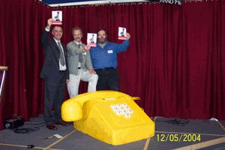

Slide 6
Celebration of CHA’s Achievements

Slide 7
Regular meeting of Members 3 or 4 Times each Year
Low Cost Membership Fee of £25/year
CHA Web Site launched 2007
Crossline’s Call Sharing from 2007/08
Annual Conferences from 2010
Regular Exhibitor at CRE’s from 2012
National Christian Helpline 2013
Notes:
Members met about 3 or 4 times a year to encourage and support each other.
No membership fee initially. Subsequently fee introduced in 2006 of £25 per year for members to cover costs of having a web presence. 10 original members reduced to 7.
In 2005 started to explore possibilities of Call Sharing amongst us. After 18 months of discussions this initially led to Crossline in Coventry taking a lead and having a new 0845 number that was managed via a Virtual Call Centre System. By end of 2008 Crossline’s in England were all working together using this system and also some of them retained their local numbers
In 2010 held our first annual conference. These have been held each year with different speakers.
Healing Reconciliation & Forgiveness – Russ Parker
Healing the Broken Hearted – Peter Horrobin
Healing in Troubled Times – John Ryeland
The Caring Heart of God – Teresa Onions

Slide 8
Current Statistics for Christian Helplines

Slide 9
11 members of CHA
Over 550 people Involved
98% of these unpaid Volunteers
Over 250,000 calls/contacts per year answered
Estimate > 400,000 total calls per year
Estimate about 500 people will contact a Christian Helpline/Prayerline each day and speak with someone

Slide 10

Christian Helplines/Prayerlines Standing in the Gap

Slide 12
Anonymous Immediacy
Non Geographic Confidential
Cost Effective Caller Centred
Reduces Impact on Statutory Services
Could save a Life Clear Boundaries in Place
Safe Space for Change Relatively Safe Sounding Board
Signposting Lifeline to Housebound
Notes:
Immediacy (Can wait 3 months to see a Counsellor), Availability in unsocial hours, Lifeline to housebound, disabled etc., Anonymous, Confidential, No Geographic Boundaries, Cost Effective – relatively cheap to run and access (much cheaper than Counselling), Caller ready to talk normally, Prevents contact with emergency services/casualty/front line health services that are expensive (reduce impact on statutory system), Caller centred and Caller Controlled (Non –threatening), Independent Sounding Board (especially if non statutory service), Enable signposting to more appropriate services if needed locally and nationally (Good first point of contact), Could save a life, Safe – no danger of abuse except verbal , Clear Boundaries in place, Can enable positive changes for the caller, Give space for caller to express what feel in unstructured way, Enable Caller to contribute to and manage their own health and wellbeing, Available to those who find it hard to engage mainstream services. Safe Space to be listened to,

Slide 13
What Callers say about Helplines
Notes:
What Callers actually feedback about their experience of calling helplines

Slide 14
“I know it’s there everyday and that reassures me even if I don’t have to call them.”
“Breaks my isolation and distress that I do not feel I can openly share with people I have a relationship with.”

Slide 15
“I know it’s kept me alive.”
“They reassure me. Never criticise, always helpful. They make me feel I am the only one they have spoken to. [I] never feel rushed, gives me hope.”

Slide 16
Thank you for the kindness and wonderful listening tonight and apologies for keeping talking beyond midnight.
God bless you for providing this special and important service and for praying

Slide 17


Slide 18
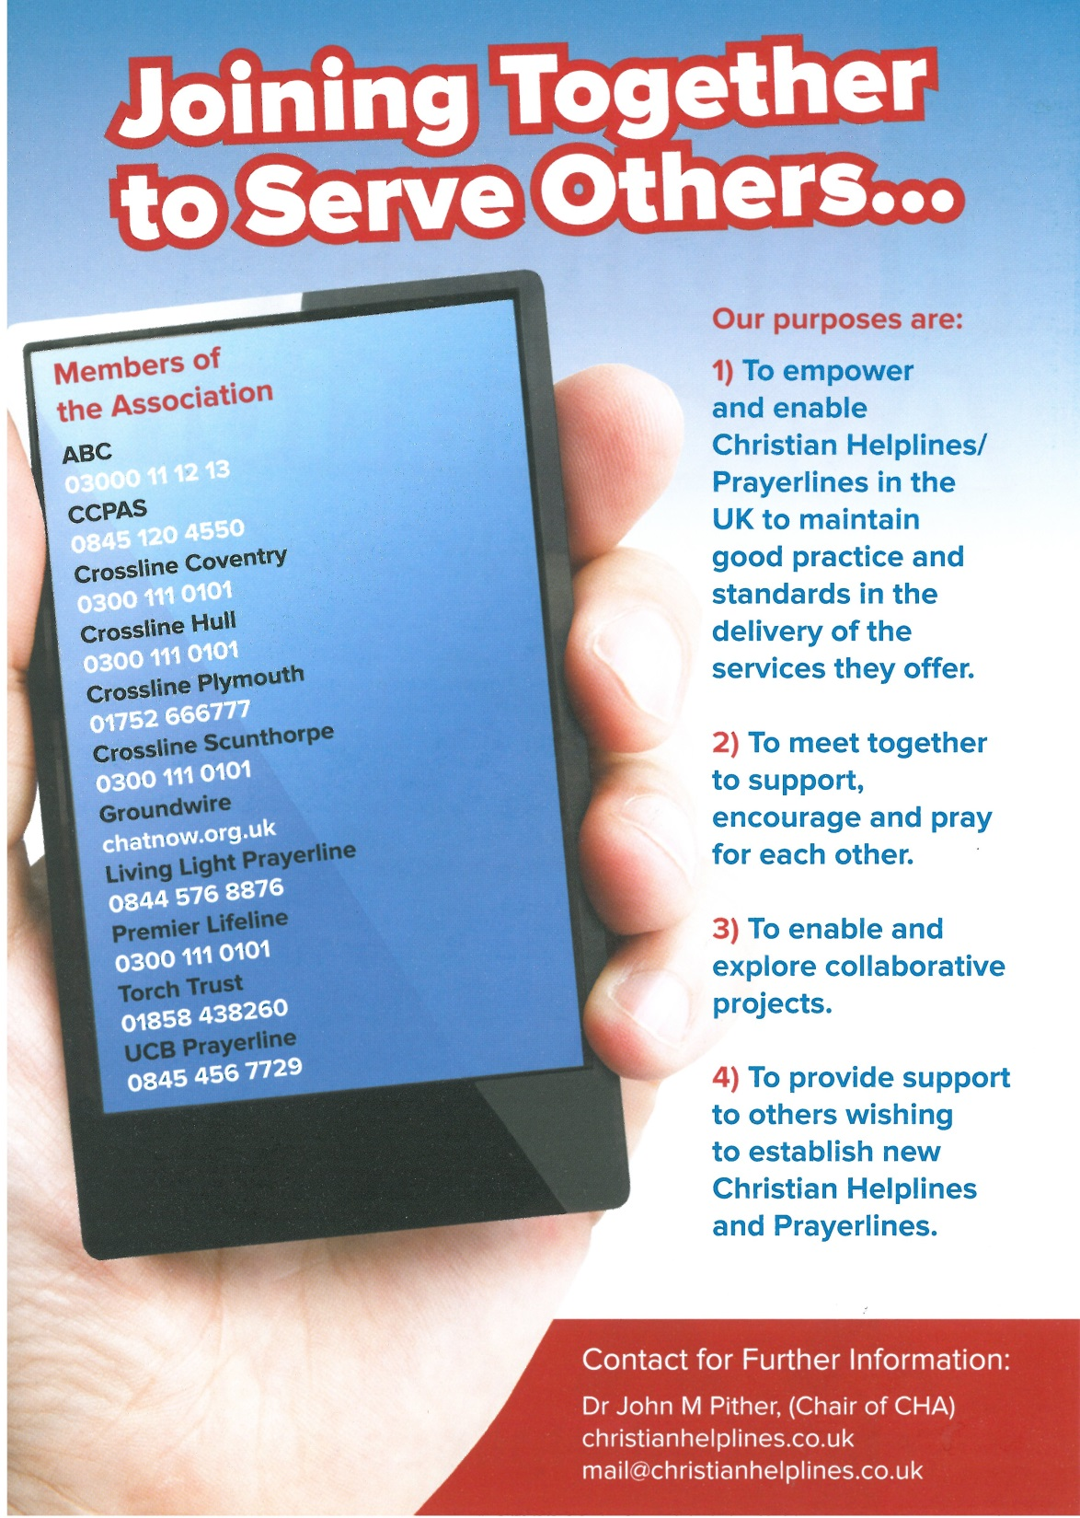

Slide 19
CHALLENGES FOR THE FUTURE

Slide 20
CHALLENGES FOR THE FUTURE
Keeping up with Technology/Social Media
&
Ever Expanding Mobile Phone Capabilities
App for Christian Helplines/Prayerlines
Challenge of Fewer landlines & Listener Volunteer Recruitment

Slide 21

Happy 10th Birthday CHA

